Slide 2



Introduction to Linux & R
Abu Bakar Siddique Bioinformatician, SLUBI, SLU

Slide 3
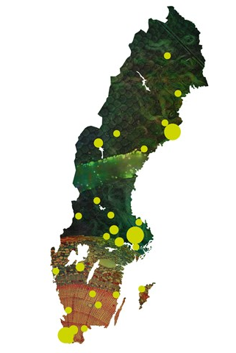
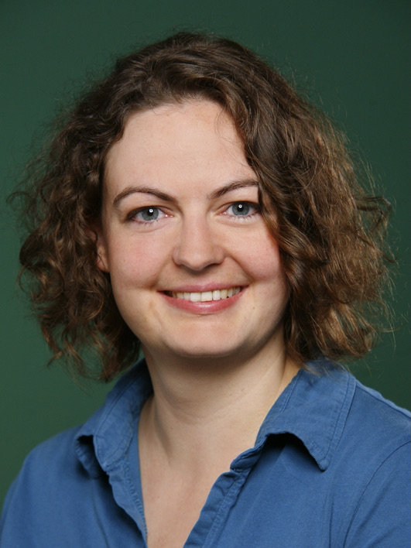




SLUBI
Created to support SLU's teachers, staff and students in the use of bioinformatics
Expertise that matches the faculty Available on-site Network of knowledge
Amrei
Nicolas
Adnan
Abu
Lizel

Slide 4
Introduction to Linux

Slide 5
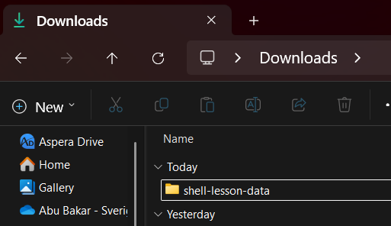
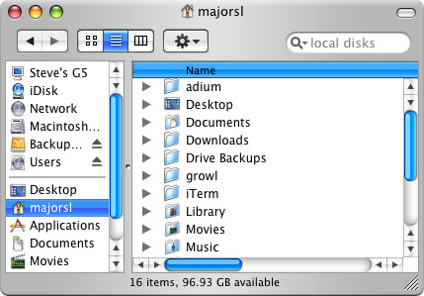
GUI

Slide 6
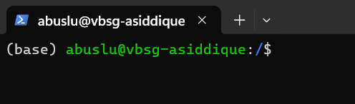
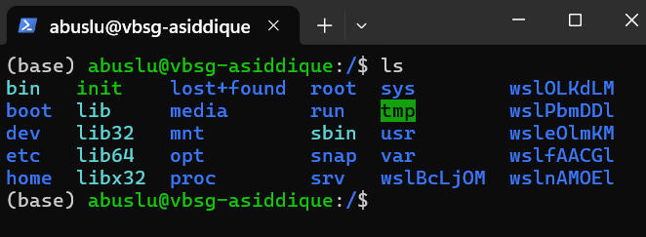
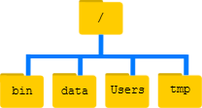
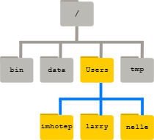
CLI (Linux)

Slide 7
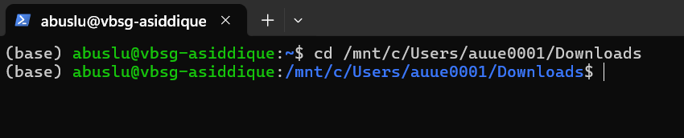
GUI vs Linux
Graphical User Interface (GUI):
visual representations
Command Line Interface (CLI): WSL, Terminal, LINUX, Ubuntu, UNIX etc
text representations
shell (or bash) is a program that allows you to control CLI with keyboard

Slide 8
Why Linux?
A powerful command-line interface (CLI)
Built for multi-user systems.
An enormous amount of software is freely available
Bioinformatics tools can only be used through a CLI
shell makes your work less boring
shell makes your work less error-prone
shell makes your work more reproducible
Computationally intensive job
Remote computer or cloud computing

Slide 9
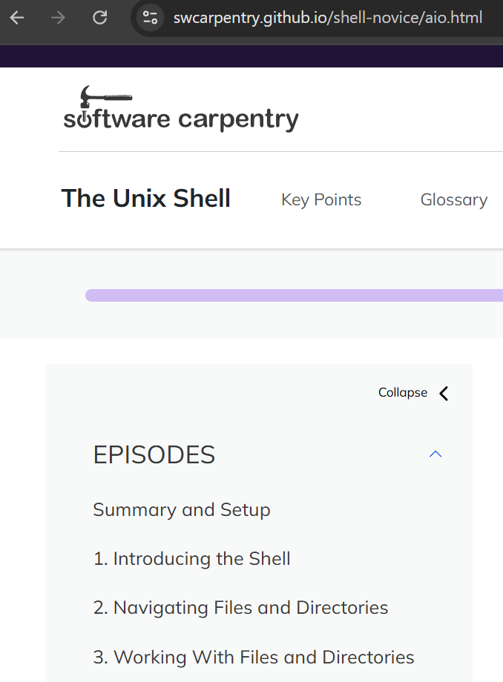
Full Tutorial
The Unix shell

Slide 10
Navigating your file system
Notes:
Bash ready

Slide 11
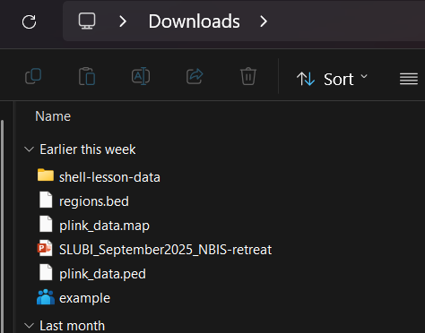
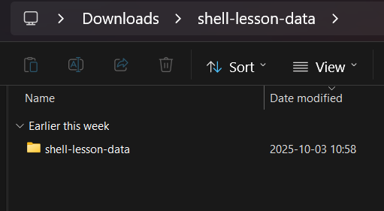
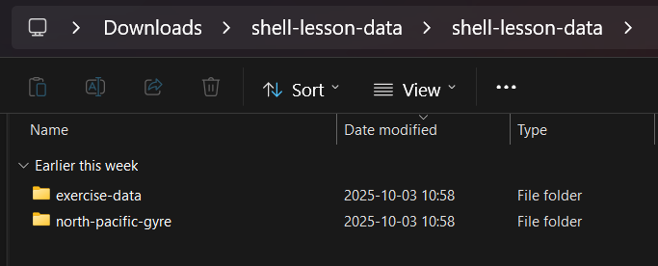
Navigating your file system

Slide 12
Linux way
Navigating your file system
cd – change working directory
"C:\Users\auue0001\Downloads\shell-lesson-data"

Slide 13
Navigating your file system

Slide 14
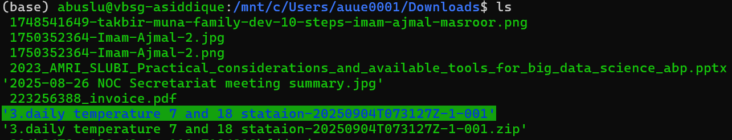
Navigating your file system
ls – list content of directory

Slide 15
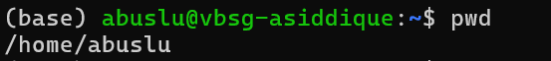
Navigating your file system
pwd – present working directory

Slide 16
Absolute/Relative path
Absolute paths
Starts with a /
Defined from the root of the file system
/mnt/c/Users/auue0001/Downloads/shell-lesson-data/shell-lesson-data/
Like an address:
Earth / Sweden / Uppsala / Ultuna / Biocentre / 4th floor / room A436

Slide 17
Absolute/Relative path
Relative paths
Does not start with a /
Relative to where you are when using it
exercise-data/numbers.txt
../exercise-data/numbers.txt
Like a direction (from Campus ultuna):
‘straight, then turn left, 4th floor, right, then left’
Or
Ultuna / Biocentre / 4th floor / room A436

Slide 18
Summary
○ ls – list content of directory
○ cd – change working directory
○ pwd – print working directory
○ absolute/relative paths

Slide 19
More practice (after lunch)
○ ls – list content of directory
○ cd – change working directory
○ pwd – print working directory
○ absolute/relative paths
○ mkdir – make a directory
○ cp – copy a file
○ mv – move a file
○ less – view a file
○ nano – view and edit a file
○ rm – remove a file
○ head / tail
○ grep
○ find
○ wildcards
○ tab completion – use it!!!
○ top – see active processes
○ man – manual pages or anycommand --help
○ exit – Log out current terminal
30 minutes…

Slide 20
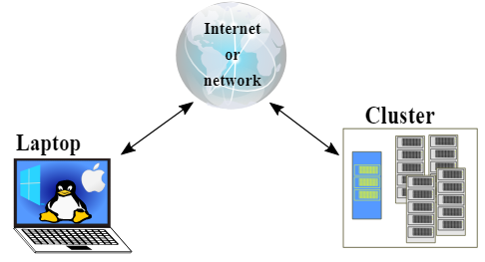
Computer cluster

Slide 21
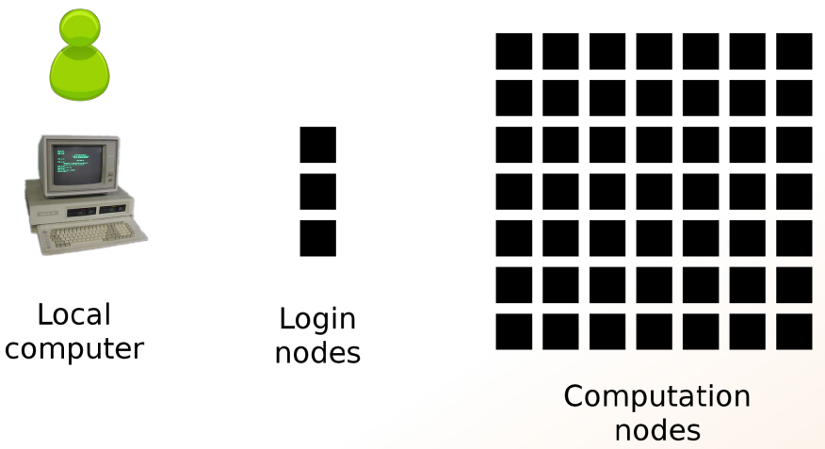
Computer cluster

Slide 22
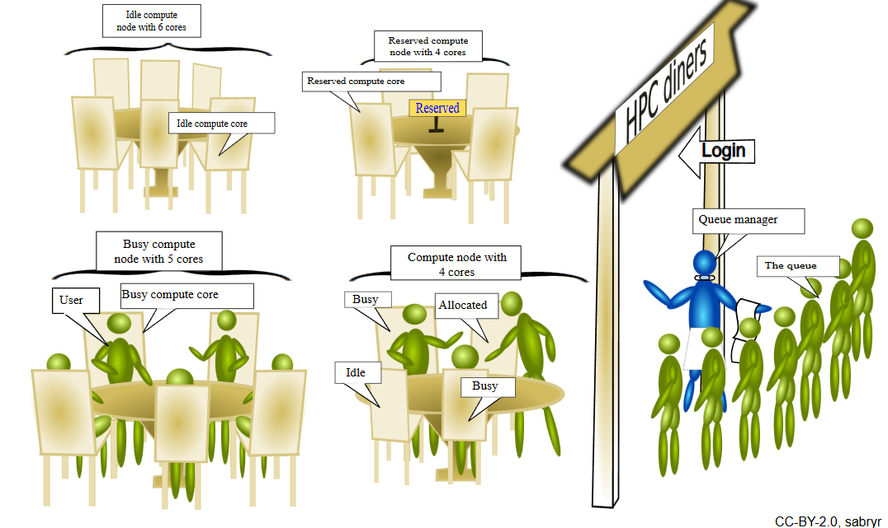
Computer cluster

Slide 23
Online materials
Unix/Linux
Data Carpentry datacarpentry/shell-genomics | website
Teaching materials at the Harvard Chan Bioinformatics Core hbctraining/Intro-to-shell-flipped | website
Ted Laderas laderast/bash_for_bioinformatics | website
SIB Swiss Institute of Bioinformatics sib-swiss/unix-first-steps-training
Software Carpentry swcarpentry/shell-novice | website
The Carpentries Lab carpentries-lab/metagenomics-shell | website
UC Davis Bioinformatics Core Training Page ucdavis-bioinformatics-training/2023-September-Introduction-to-the-Command-Line-for-Bioinformatics

Slide 24
Navigating your file system
Online terminal
https://www.terminaltemple.com/
https://copy.sh/v86/?profile=linux26&ref=itsfoss.com
17 Best Online Linux Terminals and Online Bash Editors

Slide 25
Introduction to basic R

Slide 26
Contents
About R
R vs Rstudio
Timeline
Setting a project or working directory
Interacting with R
Packages
Assign values or objects
Data types
Data structures
How to import and export data or results
Housekeeping

Slide 27

Basic about R
R is ...
a programming language
a programming platform (= environment + interpreter)
a software project driven by the core team and the community
a very powerful tool for statistical computing
a very powerful computational tool in general
Yet ...
it is very elegant
it becomes more and more feature-rich
R is not ...
a tool to replace a statistician
the very best programming language
the most elegant programming solution
the most efficient programming language

Slide 28
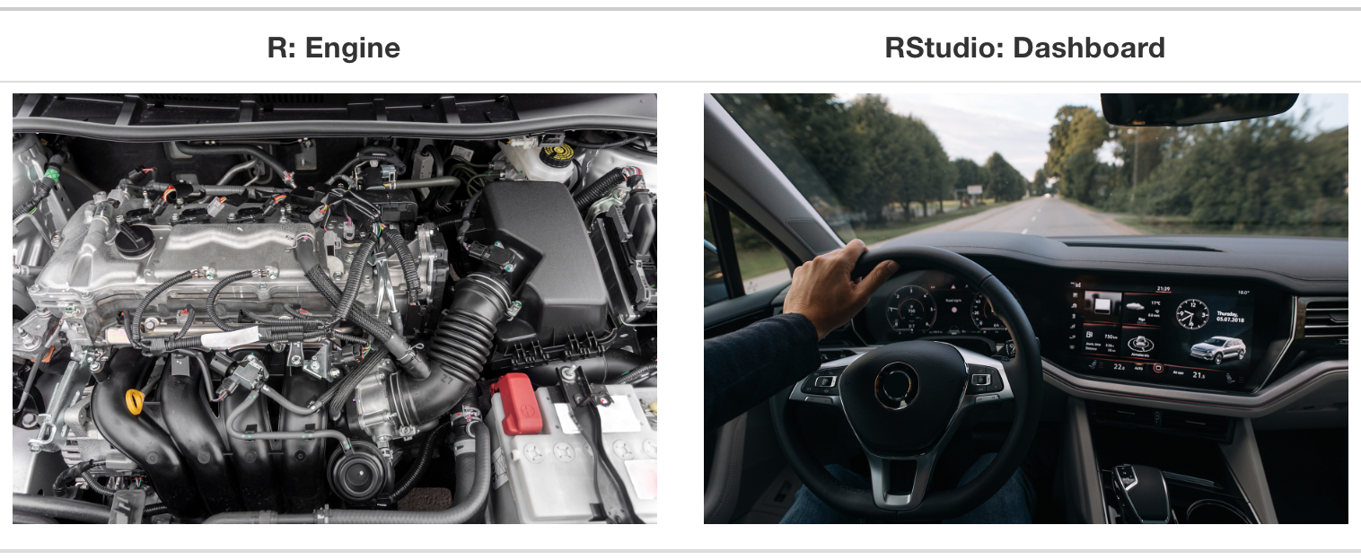
R
RStudio
Programming language
For data analysis and graphics
Refers to both the language and the software that interprets it’s scripts
Free and open source
User interface for working with R
Wrapper around the R language
Extends what R can do and facilitates writing R code
Free and open source
Notes:
You have to download them separately
Make sure to download R before installing RStudio

Slide 29
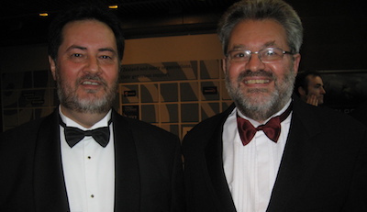
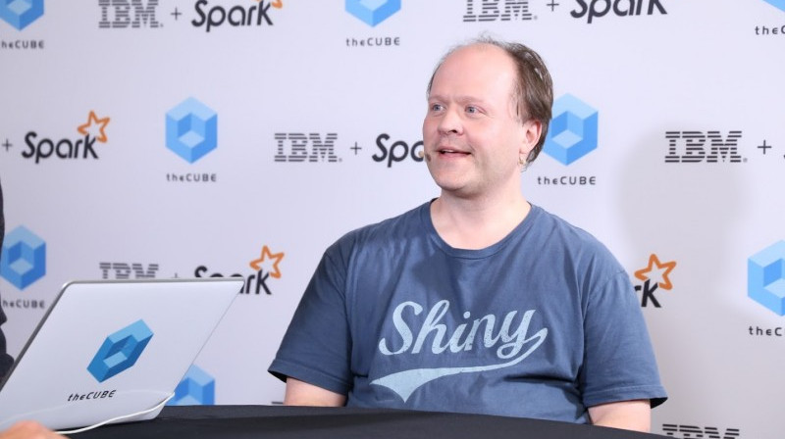
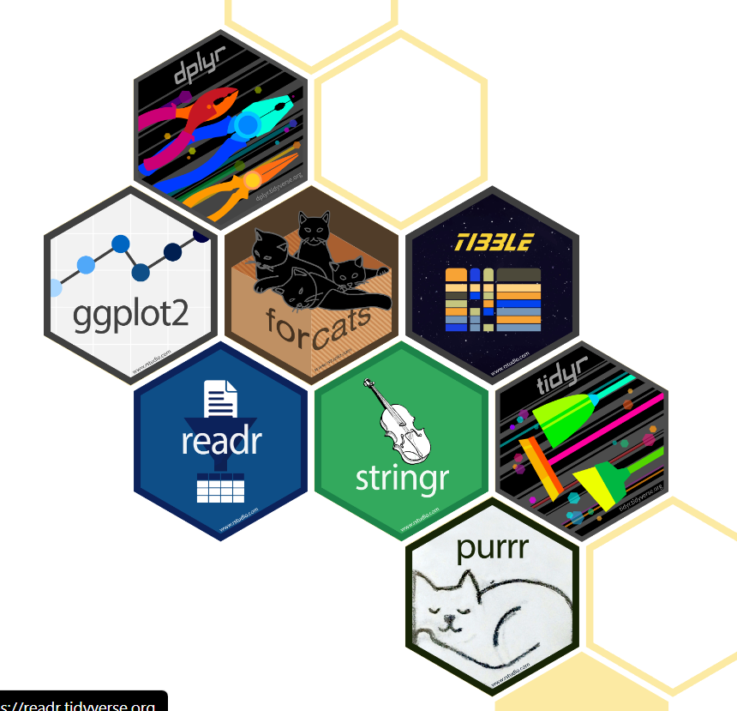

Timeline
ca. 1992 — conceived by Robert Gentleman and Ross Ihaka (R&R) at the University of Auckland, NZ as a tool for teaching statistics
1994 — initial version
2000 — stable version
2011 — RStudio, first release by J.J. Allaire
ca. 2017 — Tidyverse by Hadley Wickham

Slide 30
Setting up a project

Slide 31
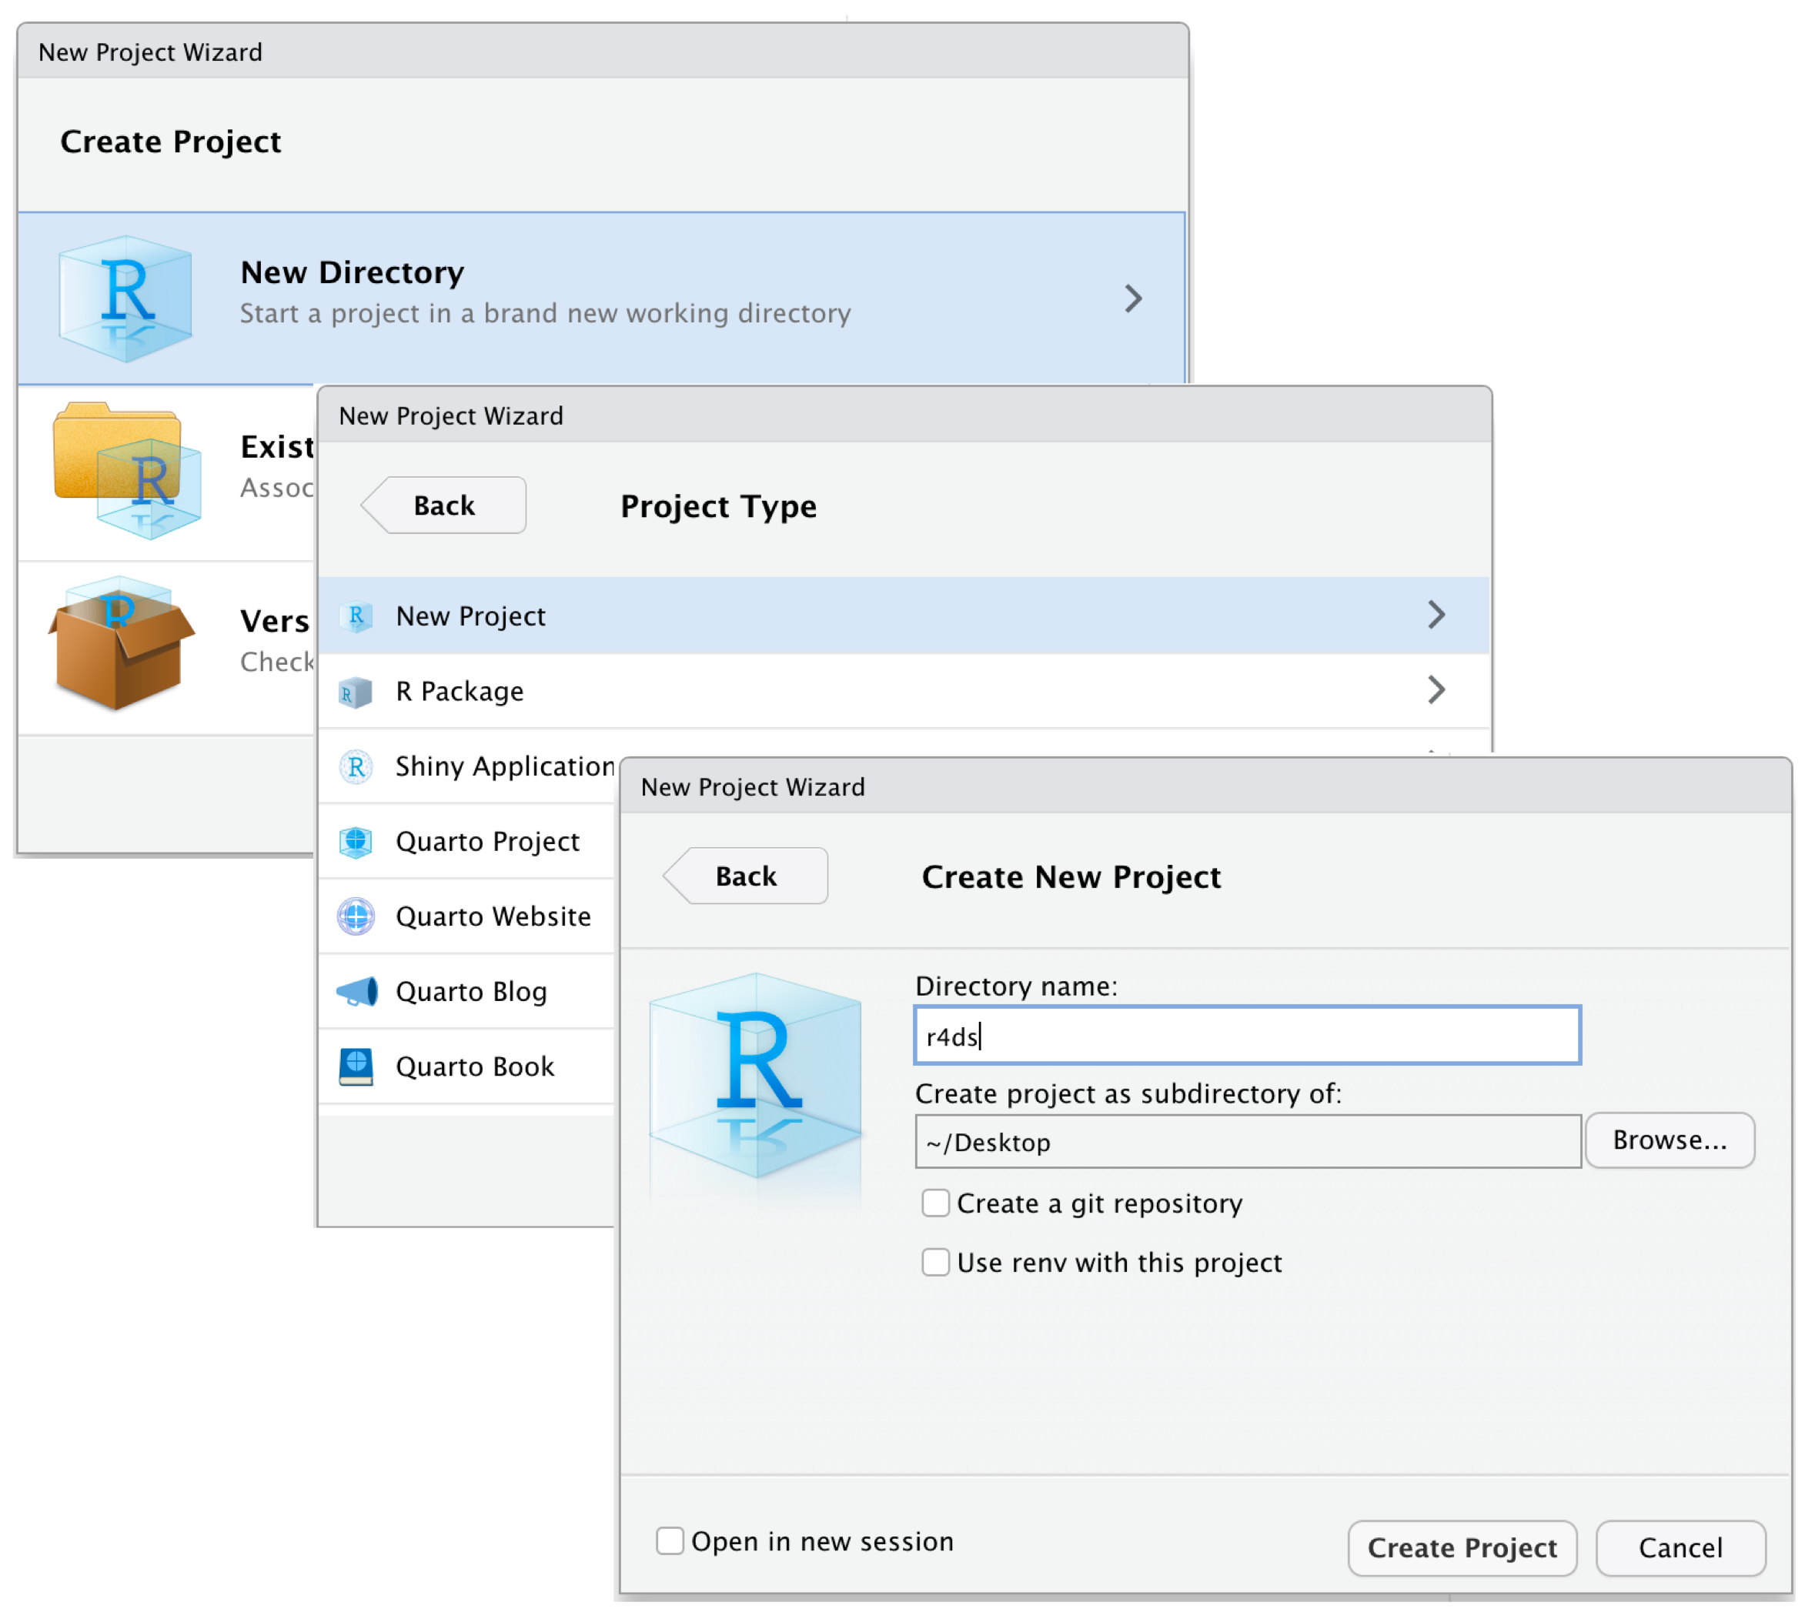
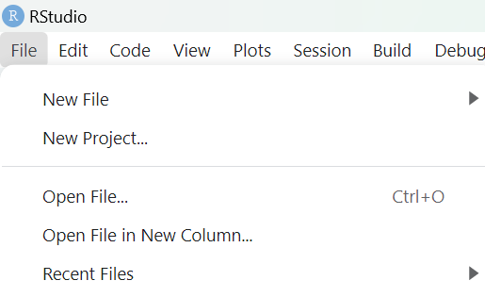

Slide 32
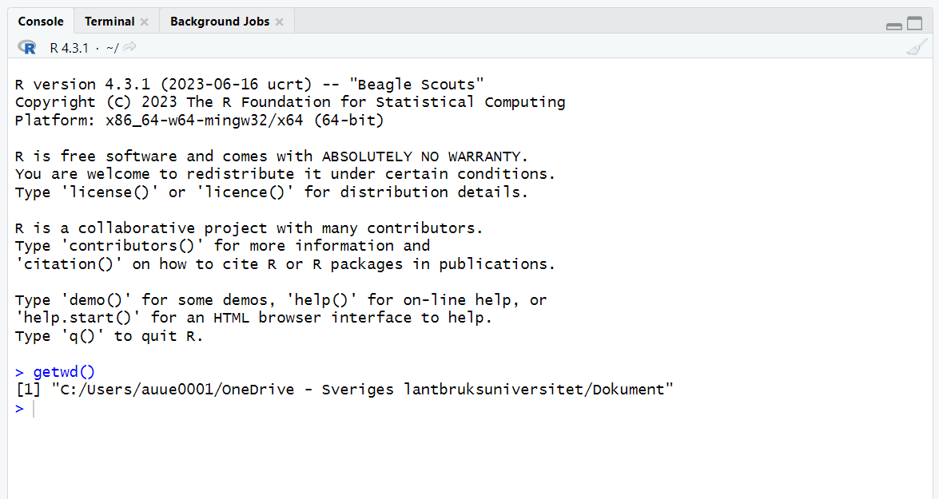
The working directory
Where R will look for and save files
Check working directory with the getwd() , setwd() functions

Slide 33
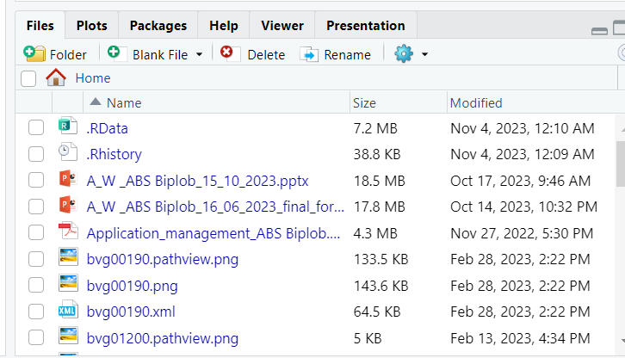
Suggested subdirectories
data/ for raw data and intermediate datasets
data_output/ modified versions of raw data
documents/ outlines, drafts, other text
fig_output/ graphics generated by scripts
scripts/ R scripts for different analyses or plotting
# create subdirectory
dir.create(path = “path_to_working_directory/data_output")

Slide 34
Interacting with R

Slide 35

Packages
developed by the community
cover several very diverse areas of science/life
uniformly structured and documented
organized in repositories:
CRAN
install.packages("tidyverse")
library("tidyverse")

Slide 36
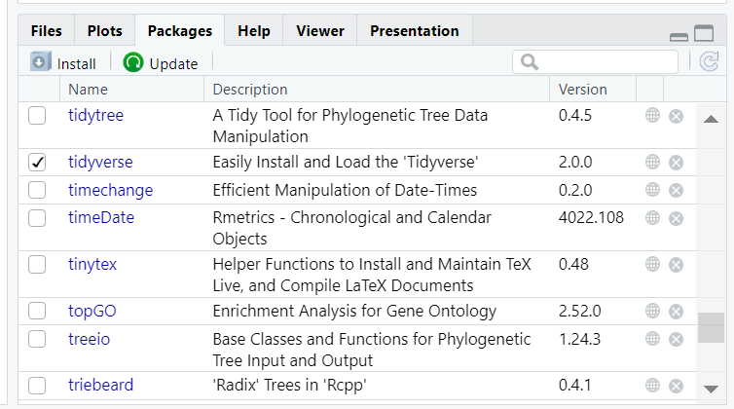
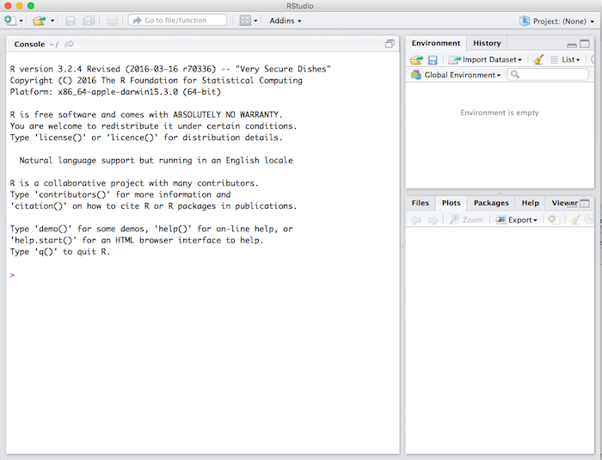
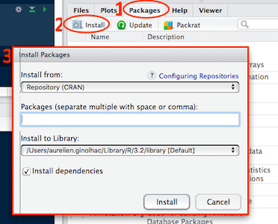
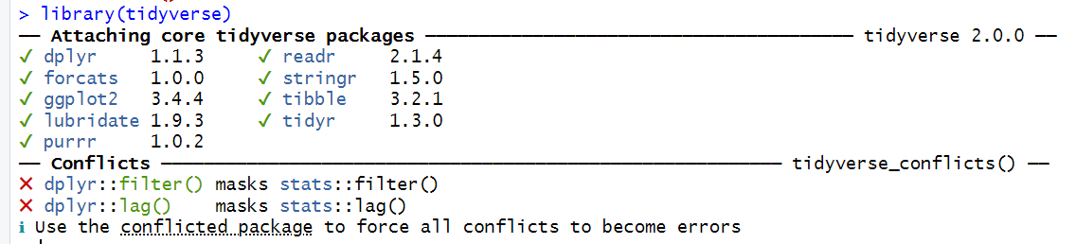
Packages
developed by the community
cover several very diverse areas of science/life
uniformly structured and documented
organized in repositories:
CRAN

Slide 37
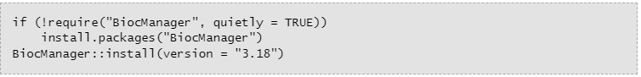
Packages
developed by the community
cover several very diverse areas of science/life
uniformly structured and documented
organized in repositories:
CRAN
Bioconductor
R-Forge
GitHub

Slide 38
Assign values to objects

Slide 39
Assign values to objects
p <- 3
x <- c(1, 6, 8)
y <- c(“car”, “truck”)
Notes:
arrow pointing at the object receiving the value of the expression.

Slide 40
Scalars, vectors and matrices

Slide 41
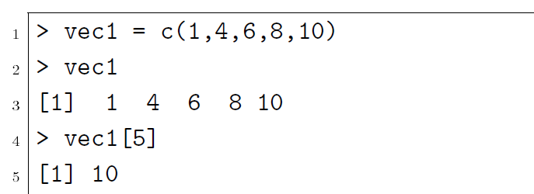
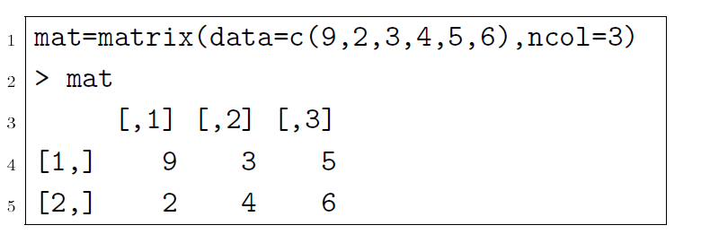
Types of vectors and objects
Scalar (0 dimention):
p <- 3
Vector (arrays -1 dimention) :
x <- c(1, 6, 8)
y <- (“car”, “truck”)
Matrix (2 dimension):
Notes:
scalars (a single number – 0-dimensional),
vectors (arow of numbers, also called arrays – 1-dimensional) and
matrices (like a table – 2-dimensional).

Slide 42
Types of vectors and objects
character: y <- (“car”, “truck”)
numeric: x <- c(1.1, 6.2, 8.4)
integer: z <- 2
logical: TRUE, FALSE
complex: 1+4i (complex numbers with real and imaginary parts)
R has many functions to examine features of vectors and other objects:,
class() - what kind of object is it (high-level)?
typeof() - what is the object’s data type (low-level)?
length() - how long is it? What about two dimensional objects?
attributes() - does it have any metadata?
Notes:
As.cah
As numeric
As intiger

Slide 43
Structures

Slide 44
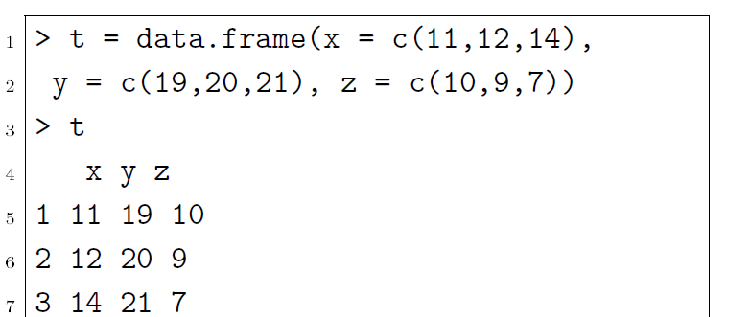
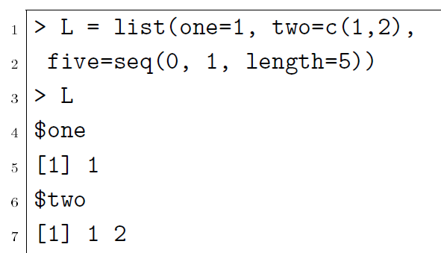
Data structures
Matrix
Data frames
Factors (r assign a level for each values)
Arrays
Lists
> x <- 1:12
> # Create a 3 x 4 array from the vector
> my_array <- array(values, dim = c(3, 4))
> # Print the array
> print(my_array)
[,1] [,2] [,3] [,4]
[1,] 1 4 7 10
[2,] 2 5 8 11
[3,] 3 6 9 12
> values
[1] 1 2 3 4 5 6 7 8 9 10 11 12
Notes:
Facotors: Factor in R is a variable used to categorize and store the data as a vector of integer values. Factor in R is also known as a categorical variable that stores both string and integer data values as levels. Factor is mostly used in Statistical Modeling and exploratory data analysis with R.
In a dataset, we can distinguish two types of variables: categorical and continuous.

Slide 45
Getting a dataset in R

Slide 46
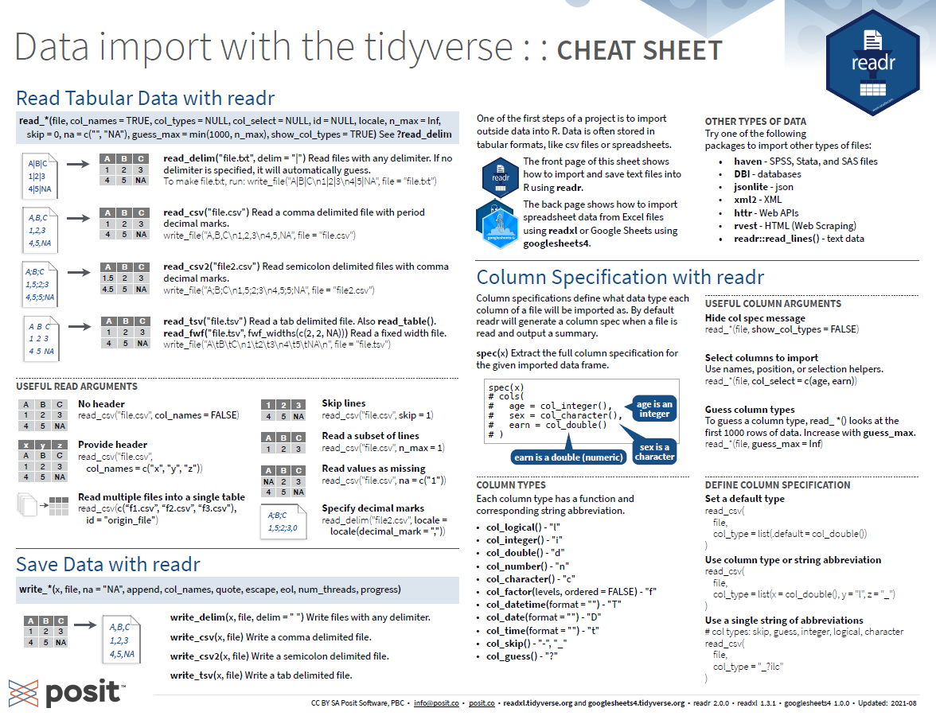
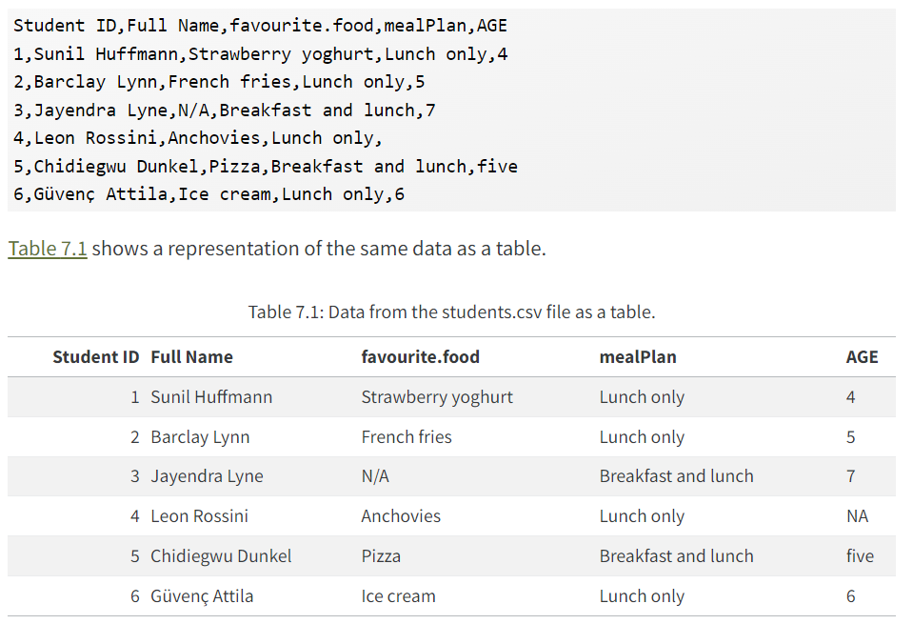
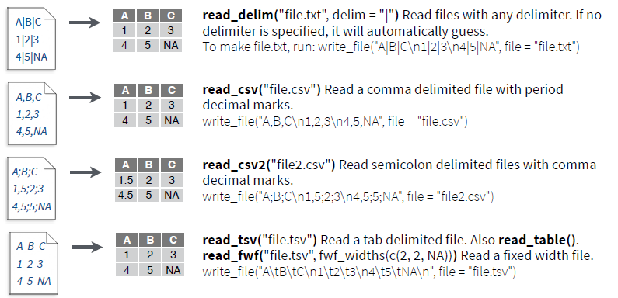
Ways to get data in R or in RStudio
Manually:
data.frame() function in Base R,
or the tibble() function in the tidyverse.
Import it from a file:
Tabular data: CSV, TSV (read.table() or read_delim() function or readr package which contains read_csv())
Excel: XLSX (xlsx package)
Google sheets: (googlesheets package)

Slide 47


Slide 48
Processes

Slide 49
How to export or save as results or data
write.csv(df , file = “path/to/your/saving/folder/df.csv")
writexl::write_xlsx (test_df, path = "C:/Users/your_username/test_df.xlsx", col_names = TRUE, format_headers = TRUE)

Slide 50
How to export or save as plot
dev.print (device=jpeg, file="path/to/your/saving/plots/figure_1a.jpg", width=par("din")[1]*300, res=300, quality=100)
ggsave("path/to/your/saving/plots/figure_1a.png", plot = p1, bg ="white")

Slide 51
!! Practical session (afternoon session): read a data file into Rstudio!!

Slide 52
Seeking help
RStudio help interface
?sum
help.search(), with term in “” inside parentheses
Google or chatgpt “R <task>”
When asking others
Use correct words
Reduce to reproducible example
Always include output of sessionInfo() function

Slide 53
Good housekeeping strategies for scripts
Comments, Structure:
Use #
Outline
Consistent Naming Conventions:
Use consistent naming conventions for variables, functions, and objects
Avoid duplicating code. create a function or use a loop
Version Control:
Git. Platforms like GitHub or GitLab repositories.
Imports and Dependencies:
List all package imports at the top of your script
call rhistory: sessionInfo()
File Organization:
Separate your R scripts, data, documentation, and output files into logical folders.
Reproducibility:
Use Quarto, R Markdown Documents:
Documentation Files:
Create README files

Slide 54

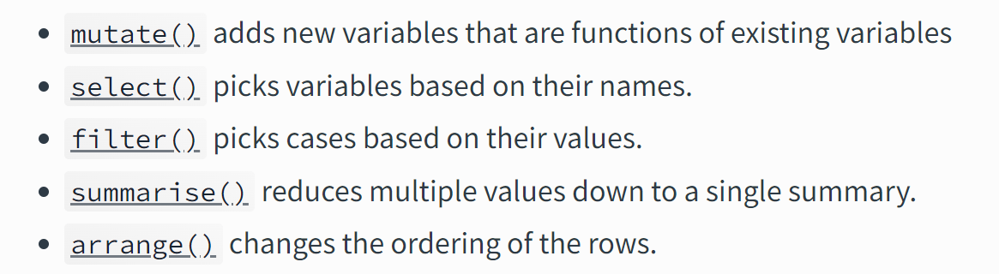
Filtering of genotype data
Subset data, metadata
Based on “rows (observations)” , “variable” or “values”
Filter
Missing data (“NA”, stat, summary)
height_sub_12 <- subset(data, height<12)
data_filter_na <- data[!is.na(data$height),]

Slide 55
Questions?!

Slide 56
Acknowledgements
NBIS(RaukR)
Shannon Alexandra Sheridan

